Slide 1
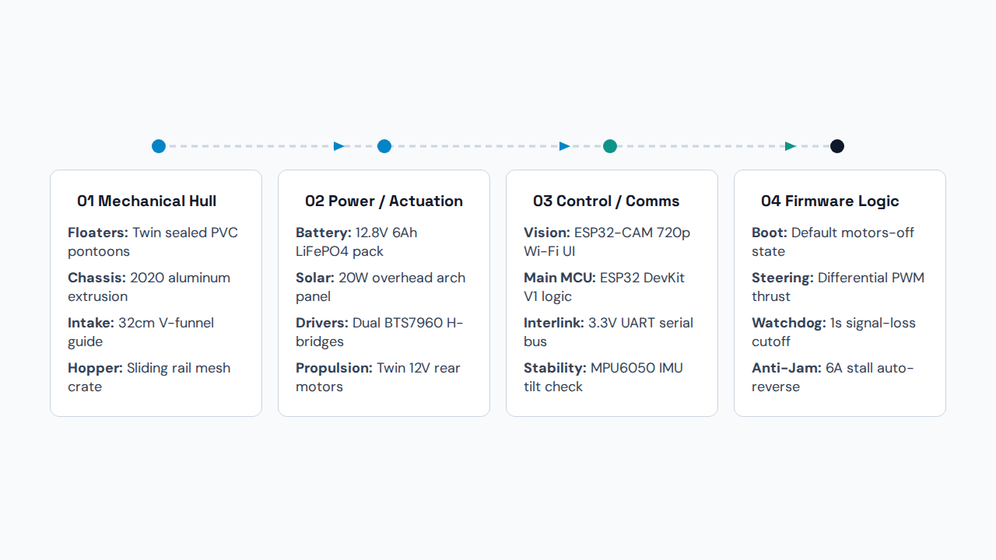
VISHWAKARMA AWARDS 2026-27 • SYSTEM ARCHITECTURE (SLIDE 5A)
System Block Diagram & Logic Flow
Architecture Rationale: Dual-MCU 3.3V UART split isolates Wi-Fi video streaming from real-time PWM motor loops; dry above-waterline motor placement prevents seal failure.

Slide 2

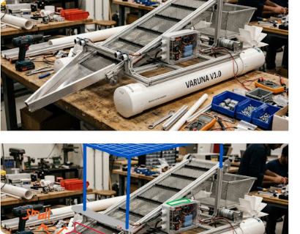
VISHWAKARMA AWARDS 2026-27 • TARGET SPECIFICATIONS (SLIDE 5B)
Engineering Target Specifications & Hardware
Parameter | Target Spec | Selected Hardware / Protocol
Vessel Envelope | 120 × 65 × 55 cm | 2020 T-slot aluminum frame + PVC hull
Mass & Payload | 8.2 kg / 8.0 kg | 35L removable mesh crate on sliding rails
Buoyancy & Draft | 36.2 L / 15.5 cm | Twin sealed PVC pipes (GM > 0.18 m)
Propulsion Drive | 360° zero-turn | 2× 12V geared/RS-775 motors + 2× BTS7960
Intake Mechanism | 32 cm V-mouth | 45 RPM grab-roller + 30 RPM SS mesh / baffle
Continuous Runtime | 102–148 mins | 12.8V 6Ah LiFePO4 (20A BMS) + 20W solar
Control & Vision | 180 m LoS Wi-Fi | ESP32-CAM (FPV) + ESP32 DevKit V1 (UART)
Figure: VARUNA V1.0 twin-pontoon 2020 aluminum prototype with IP65 junction box on lab bench.
42.2 W
₹10,250
Total Power (3.52A)
Stage 2 MVP Ceiling

